Slide 1
Numpy
NumPy is a Python package that stands for ‘Numerical Python’. It is the core library for scientific computing, which contains a powerful n-dimensional array object.
Python NumPy arrays provide tools for integrating C, C++, etc. It is also useful in linear algebra, random number capability etc. NumPy array can also be used as an efficient multi-dimensional container for generic data.
Numpy array is a powerful N-dimensional array object which is in the form of rows and columns.
Single Dimensional NumPy Array
import numpy as np
a=np.array([1,2,3])
print(a)
Muti-Dimensional NumPy Array
a=np.array([[1,2,3],[4,5,6]])
print(a)

Slide 2
Python NumPy Array v/s List
Python NumPy array is preferred instead of a list because of the below three reasons:
Less Memory: First reason to choose python NumPy array is that it occupies less memory as compared to list.
import numpy as np
import time
import sys
S= range(1000)
print(sys.getsizeof(5)*len(S))
D= np.arange(1000)
print(D.size*D.itemsize)
Output: 28000 8000
The above output shows that the memory allocated by list (denoted by S) is 28000 whereas the memory allocated by the NumPy array is just 8000.

Slide 3
Python NumPy Array v/s List
Fast: It is pretty fast in terms of execution and at the same time
Convenient: It is very convenient to work with NumPy
import numpy as np
import time
import sys
SIZE = 1000000
L1= range(SIZE)
L2= range(SIZE)
A1= np.arange(SIZE)
A2=np.arange(SIZE)
start= time.time()
result=[(x,y) for x,y in zip(L1,L2)]
print((time.time()-start)*1000)
start=time.time()
result= A1+A2
print((time.time()-start)*1000)
Output: 152.01520919799805
40.41934013366699

Slide 4
How to create NumPy array?
To create a NumPy array we need to pass list of element values inside a square bracket as an argument to the np.array() function.A 3d array is a matrix of 2d array. A 3d array can also be called as a list of lists where every element is again a list of elements.
import numpy as np
array1d = np.array([1, 2, 3, 4, 5, 6])
array2d = np.array([[1, 2, 3], [4, 5, 6]])
array3d = np.array([[[1, 2, 3], [4, 5, 6]], [[7, 8, 9], [10, 11, 12]]])
print(array1d)
print("-" * 10)
print(array2d)
print("-" * 10)
print(array3d)

Slide 5
How to create NumPy array using arange function?
The arange() function creates an array with evenly spaced values between the specified start, end, and increment values.
General form: np.arange(Start, End, Increment)
import numpy as np
array1d = np.arange(5) # 1 row and 5 columns
print(array1d)
array1d = np.arange(0, 12, 2) # 1 row and 6 columns
print(array1d)
array2d = np.arange(0, 12, 2).reshape(2, 3) # 2 rows 3 columns print(array2d)
array3d = np.arange(9).reshape(3, 3) # 3 rows and columns print(array3d)

Slide 6
Q1: How do you convert a one dimensional array with 6 elements to a two dimensional array in Python?
Hint: newarr = arr.reshape(2, 3)
Q2: How to convert 1-D array with 12 elements into a 3-D array in Numpy Python?
Hint: newarr = arr.reshape(2, 3, 2)
Q3: How to convert 1d to 2d array with 1 column?
Hint: newarr = arr.reshape(arr.shape[0], -1)
Q4: How do you reshape a 3D array in Python?
Hint: newarr = arr.reshape(2, 3, 2)
newarr = arr.reshape(3, 2, 2)
newarr = arr.reshape(2, 2, 3)

Slide 7
Array attributes
How can I find the dimensions of a Numpy array in Python?
Hint : array.ndim
How to get the transpose of a NumPy array in Python?
Hint : array.T
a = np.arange(10).reshape((2,5))
a.ndim # 2 dimension
a.shape # (2, 5) shape of array
a.size # 10 # of elements
a.T # transpose
a.dtype # data type

Slide 8
The dtype method determines the datatype of elements stored in NumPy array. You can also explicitly define the data type using the dtype option as an argument of array function.
import numpy as np
type1 = np.array([1, 2, 3, 4, 5, 6])
type2 = np.array([1.5, 2.5, 0.5, 6])
type4 = np.array(["Canada", "Australia"], dtype='U5')
type5 = np.array([555, 666], dtype=float)
print(type4.dtype)
print(type5.dtype)
Output:
<U5 float64

Slide 9
The resize() method modifies existing shape and array itself:
import numpy as np
thearray = np.array([1, 2, 3, 4, 5, 6, 7, 8])
thearray.resize(4)
print(thearray)
print("-" * 10)
thearray = np.array([1, 2, 3, 4, 5, 6, 7, 8])
thearray.resize(2, 4)
print(thearray)
Output:
[1 2 3 4] ---------- [[1 2 3 4] [5 6 7 8]]

Slide 10
The linspace() function generates an array with evenly spaced values between specified start and end values, using a specified number of elements. General form: np.linspace(Start, End, Number of elements)
import numpy as np
array1d = np.linspace(1, 12, 2)
print(array1d)
array2d = np.linspace(1, 12, 12).reshape(4, 3)
print(array2d)
Output:
[ 1. 12.] [[ 1. 2. 3.] [ 4. 5. 6.] [ 7. 8. 9.] [10. 11. 12.]]

Slide 11
The ones() function, generates an array with the specified dimensions and data type that is filled with ones.
import numpy as np
array1d = np.ones(3)
print(array1d)
array2d = np.ones((2, 4))
print(array2d)
Sample output of above program.
[1. 1. 1.] [[1. 1. 1. 1.] [1. 1. 1. 1.]]

Slide 12
The np.random.rand method, generates an array with random numbers that are uniformly distributed between 0 and 1.
The np.random.randn method, generates an array with random numbers that are normally distributed between 0 and 1.
The np.random.randint method, generates an array with random numbers that are uniformly distributed between 0 and given integer.
import numpy as np
print(np.random.rand(3, 2)) # Uniformly distributed values. print(np.random.randn(3, 2)) # Normally distributed values.
print(np.random.randint(2, size=10)) # Uniformly distributed integers in a given range.
Sample output of above program.
[[0.68428242 0.62467648] [0.28595395 0.96066372] [0.63394485 0.94036659]] [[0.29458704 0.84015551] [0.42001253 0.89660667] [0.50442113 0.46681958]] [0 1 1 0 0 0 0 1 0 0]

Slide 13
Slicing allows to extract portions of an array or select a subset of an existing array to generate new arrays.
import numpy as np
array1d = np.array([0, 1, 2, 3, 4, 5, 6, 7, 8, 9])
print(array1d[4:]) # From index 4 to last index #[4 5 6 7 8 9]
print(array1d[:4]) # From index 0 to 4 index ( Excluded) #[0 1 2 3]
print(array1d[4:7]) # From index 4(included) up to index 7(excluded)
#[4 5 6]
print(array1d[:-1]) # Excluded last element # [0 1 2 3 4 5 6 7 8]
print(array1d[:-2]) # Up to second last index(negative index)
#[0 1 2 3 4 5 6 7]
print(array1d[::-1]) # From last to first in reverse order(negative step)
# [9 8 7 6 5 4 3 2 1 0]
print(array1d[::-2]) # All odd numbers in reversed order #[9 7 5 3 1]
print(array1d[-2::-2]) # All even numbers in reversed order #[8 6 4 2 0]
print(array1d[::]) # All elements #[0 1 2 3 4 5 6 7 8 9]

Slide 14
Arithmetic Operations with NumPy Array
The arithmetic operations with NumPy arrays perform element-wise operations, this means the operators are applied only between corresponding elements.
import numpy as np
array1 = np.array([[1, 2, 3], [4, 5, 6]])
array2 = np.array([[7, 8, 9], [10, 11, 12]])
print(array1 + array2)
print(array1 - array2)
print(array1 * array2)
print(array2 / array1)
print(array1 ** array2)
output of array1+array2
[[ 8 10 12]
[14 16 18]]
output of array1-array2
[[-6 -6 -6]
[-6 -6 -6]]

Slide 15
NumPy Logical operations for selectively picking values from an array depending on a given condition
logical_or computes the truth value of x1 OR x2 element-wise.
logical_and computes truth value of x1 AND x2 element-wise.
logical_not computes the truth value of NOT x element-wise.
import numpy as np
thearray = np.array([[10, 20, 30], [14, 24, 36]])
print(np.logical_or(thearray < 10, thearray > 15))
print(np.logical_and(thearray < 10, thearray > 15))
print(np.logical_not(thearray < 20))
[[False True True]
[False True True]]
[[False False False]
[False False False]]
[[False True True]
[False True True]]

Slide 16
How to check if a NumPy array is empty in Python?
Use numpy.array.size to check if array is empty
import numpy as np
the_array = np.array([])
is_empty = the_array.size == 0
print(is_empty)
the_array = np.array([1, 2, 3])
is_empty = the_array.size == 0
print(is_empty)
Output:
True
False

Slide 17
examples to filter a NumPy array based on two conditions in Python
import numpy as np
the_array = np.array([1, 2, 3, 4, 5, 6, 7, 8, 9])
filter_arr = np.logical_or(the_array < 3, the_array == 4)
print(the_array[filter_arr])
Output: [1,2,4]
import numpy as np the_array = np.array([1, 2, 3, 4, 5, 6, 7, 8, 9]) filter_arr = np.logical_and(np.greater(the_array, 3), np.less(the_array, 8)) print(the_array[filter_arr]) Output: [4,5,6,7]

Slide 18
How to remove nan values if any?
import numpy as np
x = np.array([np.nan, 2, 3, 4])
x = x[~np.isnan(x)]
print(x)
Output: [2. 3. 4.]

Slide 19
How to repeat a column in NumPy array in Python?
import numpy as np
the_array = np.array([1, 2, 3])
repeat = 3
new_array = np.transpose([the_array] * repeat)
print(new_array)
Output:
[[1 1 1]
[2 2 2]
[3 3 3]]

Slide 20
Convert Numpy array to JSON
import numpy as np
the_array = np.array([[49, 7, 44], [27, 13, 35], [27, 13, 35]])
lists = the_array.tolist()
print([{'x': x[0], 'y': x[1], 'z': x[2]} for i, x in enumerate(lists)])
Output:
[{'x': 49, 'y': 7, 'z': 44}, {'x': 27, 'y': 13, 'z': 35},
{'x': 27, 'y': 13, 'z': 35}]

Slide 21
Replacing elements in a Numpy array when there are multiple conditions
import numpy as np
the_array = np.array([49, 7, 44, 27, 13, 35, 71])
an_array = np.where(the_array > 30, 0, the_array)
print(an_array)
Output:
[ 0 7 0 27 13 0 0]

Slide 22
How to append a NumPy array in Python?
import numpy as np
the_array = np.array([[0, 1], [2, 3]])
row_to_append = np.array([[4, 5]])
the_array = np.append(the_array, row_to_append, 0)
print(the_array)
print('*' * 10)
columns_to_append = np.array([[7], [8], [9]])
the_array = np.append(the_array, columns_to_append, 1)
print(the_array)
Output:
[[0 1] [2 3] [4 5]]
**********
[[0 1 7]
[2 3 8]
[4 5 9]]

Slide 23
How to sort a NumPy array in descending order?
import numpy as np
the_array = np.array([49, 7, 44, 27, 13, 35, 71])
sort_array = np.sort(the_array)[::-1]
print(sort_array)
Output:
[71 49 44 35 27 13 7]
import numpy as np
the_array = np.array([[49, 7, 4], [27, 13, 35], [12, 3, 5]])
a_idx = np.argsort(-the_array)
sort_array = np.take_along_axis(the_array, a_idx, axis=1)
print(sort_array)
Output:
[[49 7 4] [35 27 13] [12 5 3]]

Slide 24
How to convert List or Tuple into NumPy array?
The array() function can accept lists, tuples and other numpy.ndarray objects also to create new array object.
import numpy as np
thelist = [1, 2, 3]
print(type(thelist)) # <class 'list'>
array1 = np.array(thelist)
print(type(array1)) # <class 'numpy.ndarray'>
thetuple = ((1, 2, 3))
print(type(thetuple)) # <class 'tuple'>
array2 = np.array(thetuple)
print(type(array2)) # <class 'numpy.ndarray'>

Slide 25
NumPy Identity and Diagonal Array
The identity() function, generates square array with ones on the main diagonal whereas diag() function extract or construct diagonal array.
import numpy as np
print(np.identity(3))
print(np.diag(np.arange(0, 8, 2)))
Output:
[[1. 0. 0.] [0. 1. 0.] [0. 0. 1.]] [[0 0 0 0] [0 2 0 0] [0 0 4 0] [0 0 0 6]]

Slide 26
NumPy Eye array
The eye() function, returns an array where all elements are equal to zero, except for the k-th diagonal, whose values are equal to one.
import numpy as np
array1 = np.eye(3, dtype=int)
print(array1)
Output:
[[1 0 0] [0 1 0] [0 0 1]]

Slide 27
NumPy Full array
The full() function, generates an array with the specified dimensions and data type that is filled with specified number.
import numpy as np
array1d = np.full((3), 2)
print(array1d)
array2d = np.full((2, 4), 3)
print(array2d)
Output:
[2 2 2] [[3 3 3 3] [3 3 3 3]]

Slide 28
ravel There is one more operation where you can convert one numpy array into a single column i.e ravel. Let us see how it is implemented practically:
import numpy as np
x= np.array([(1,2,3),(3,4,5)])
print(x.ravel())
Output – [ 1 2 3 3 4 5]

Slide 29
Create a Boolean array Create a 3×3 numpy array of all True’s
import numpy as np
a=np.full((3, 3), True, dtype=bool)
print(a)
Output:
[[ True, True, True],
[ True, True, True],
[ True, True, True]]

Slide 30
Array broadcasting
When operating on two arrays, numpy compares shapes. Two dimensions are compatible when
They are of equal size
One of them is 1

Slide 31
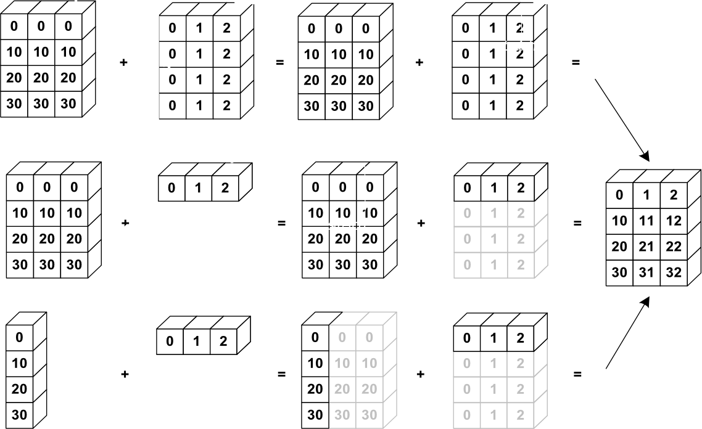
Array broadcasting

Slide 32
Array broadcasting with scalars
This also allows us to add a constant to a matrix or multiply a matrix by a constant
A = np.ones((3,3))
print 3 * A - 1
# [[ 2. 2. 2.]
# [ 2. 2. 2.]
# [ 2. 2. 2.]]

Slide 33
Vector operations
inner product
outer product
dot product (matrix multiplication)
# note: numpy automatically converts lists u = [1, 2, 3]
v = [1, 1, 1]
np.inner(u, v) # 6
np.outer(u, v)
# array([[1, 1, 1],
# [2, 2, 2],
# [3, 3, 3]])
np.dot(u, v) # 6

Slide 34
Matrix operations
First, define some matrices:
A = np.ones((3, 2))
# array([[ 1., 1.],
# | [ 1., | 1.],
# | [ 1., | 1.]])
A.T
# array([[ 1., |  | 1., | 1.],
# [ 1., |  | 1., | 1.]])
B = np.ones((2, 3))
# array([[ 1., 1., 1.],
# [ 1., 1., 1.]])

Slide 35
Matrix operations
np.dot(A, B)
# | array([[ 2., | 2., 2.],
# | [ 2., | 2., 2.],
# | [ 2., | 2., 2.]])
np.dot(B, A) # array([[ 3., |  | 3.],
# [ 3., |  | 3.]])
np.dot(B.T, A.T)
# array([[ 2., 2.,
2.],
2.],
2.]])
# #
[ 2., 2.,
[ 2., 2.,
np.dot(A, B.T)
# Traceback (most recent call last):
# File "<stdin>", line 1, in <module>
# ValueError: shapes (3,2) and (3,2) not aligned: ... # ... 2 (dim 1) != 3 (dim 0)

Slide 36
Operations along axes
a = np.random.random((2,3))
# array([[ 0.9190687 , 0.36497813, 0.75644216],
# [ 0.91938241, 0.08599547, 0.49544003]])
a.sum()
# 3.5413068994445549
a.sum(axis=0) # column sum
# array([ 1.83845111, 0.4509736 , 1.25188219])
a.cumsum()
# array([ 0.9190687 , 1.28404683, 2.04048899, 2.9598714 ,
# 3.04586687, 3.5413069 ])
a.cumsum(axis=1) # cumulative row sum
# array([[ 0.9190687 , 1.28404683, 2.04048899],
# [ 0.91938241, 1.00537788, 1.50081791]])
a.min()
# 0.0859954690403677
a.max(axis=0)
# array([ 0.91938241, 0.36497813, 0.75644216])

Slide 37
Slicing arrays
More advanced slicing
a = np.random.random((4,5)) a[2, :]
# third row, all columns
a[1:3]
# 2nd, 3rd row, all columns a[:, 2:4]
# all rows, columns 3 and 4

Slide 38
Iterating over arrays
Iterating over multidimensional arrays is done with respect to the first axis: for row in A
Looping over all elements: for element in A.flat

Slide 39
https://stackabuse.com/numpy-tutorial-a-simple-example-based-guide/
https://www.pythonprogramming.in/numpy-tutorial-with-examples-and-solutions/numpy-convert-1-d-array-with-8-elements-into-a-2-d-array-in-python.html
https://www.pythonprogramming.in/numpy-tutorial-with-examples-and-solutions.html
https://stackabuse.com/numpy-tutorial-a-simple-example-based-guide/
https://www.edureka.co/blog/python-numpy-tutorial/

